Slide 1
SCIKIT LEARN
MACHINE LEARNING

Slide 2
WHAT IS SCIKIT LEARN
Scikit-learn is a machine learning library for Python. It has many features like regression, classification and clustering algorithms including SVMs, gradient boosting, k-means, random forests, and DBSCAN. It is designed to work with Numpy and Pandas library. Scikit learn is written in Python (most of it), and some of its core algorithms are written in Cython(C extensions for Python) for even better performance.
Scikit-learn is used to build the Machine Learning models, and it is not recommended to use it for reading, manipulating and summarizing data as there are better frameworks available for the purpose like Pandas and NumPy.
You can install it using the following command.
pip install scikit-learn

Slide 3
Import NumPy and Scikit learN
So, let’s import two libraries.
import numpy as np
from sklearn.preprocessing
import MinMaxScaler
First, we have imported NumPy library, and then we have imported MinMaxScaler module fromsklearn.preprocessing library.
MinMaxScaler module is used when we need to do feature scaling to the data.
Feature scaling means, in the particular column, you will find the highest value and divide all the values with that highest value. That means, now, your column has only values between 0 to 1.
The MinMaxScaler is the probably the most popular scaling algorithm when we are working with large sets of data especially in building Machine Learning model.

Slide 4
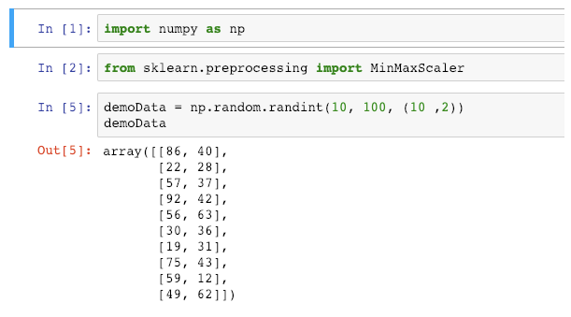
Create a demo data using NumPy
LETS CRE
demoData = np.random.randint(10, 100, (10 ,2))
demoData
So, we have created a random integer data between 10 to 100 with ten rows and two columns. The data is a random number generated so that yours might be different. But focus on Sklearn algorithms.

Slide 5
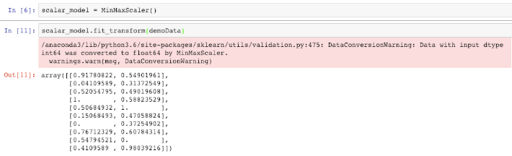
Let’s transform data
As we have created a demo data, now it is time to scaling that data. So, we will use the feature scaling. First, create an object of MinMaxScalar. Then pass the demoData to that MinMaxScalar’s fit_transform function.
scalar_model = MinMaxScaler() scalar_model.fit_transform(demoData)
Ignore the red warning; it is just telling us that, we are converting integer data to floating data when we have transformed the value using MinMaxScalar.

Slide 6
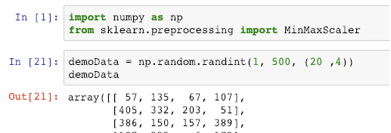
Create a DataFrame
For, splitting the data, first, we need to create a Dataframe, and for that, we need to import the Pandas library.
Now, we will create the demo data again, but this time, we will create a large dataset and then create a DataFrame from that data and then split that data to train and test.
Write the following code in one by one cell.
import numpy as np
from sklearn.preprocessing
import MinMaxScaler
Then write the following code in the next cell.
demoData = np.random.randint(1, 500, (20 ,4))
demoData

Slide 7
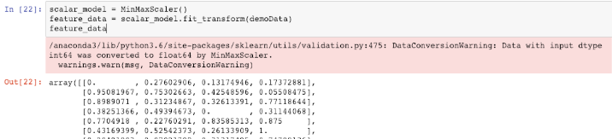
Now transform the data to create feature scaling. So, write the following code inside the cell.
scalar_model = MinMaxScaler()
feature_data = scalar_model.fit_transform(demoData)
feature_data
It will display the scaled data.

Slide 8
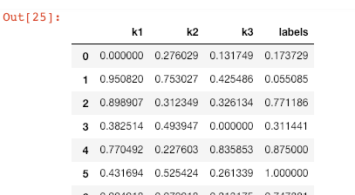
Next step is to create a DataFrame from above data.
So, write the following code in the next cell.
import pandas as pd
df = pd.DataFrame(data=feature_data, columns=['k1', 'k2', 'k3', 'labels'])
Df
We have imported the pandas and created a DataFrame from the above feature_data. We have also defined the columns for the data. See the scaled data.
We have three columns of featured data, and one column label is to predict the values. It is a supervised problem.

Slide 9
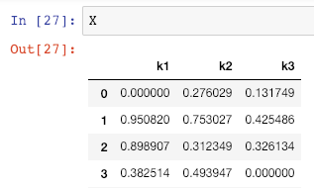
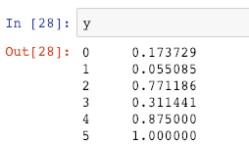
Split the data into Train and Test
First, let’s split the data between features and label. So, write the following code in the next cell.
X = df[['k1', 'k2', 'k3']]
y = df['labels']
Now, print the X and y and see the output.
See the y in the output

Slide 10
So, now we have feature X and predict the label the data y. Let’s do the train and test split.
from sklearn.model_selection import train_test_split
Now, write the following code in the next cell.
X_train, X_test, y_train, y_test = train_test_split(X, y, test_size=0.30, random_state=42)
Run the cell.
What above code does is that it will split the data between X_train and X_test with the 1:3. Means, train data gets 70%, and test data get 30% from the DataFrame.
You can change the percentage you want for the test and train data, but this ratio is the standard ratio to split the data between train and test.

Slide 11
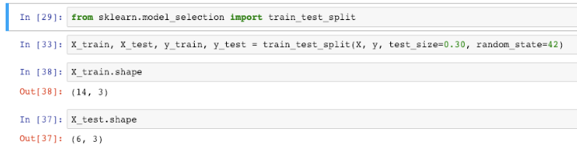
We can check, how much data, we get for the train and test data. Type the following code in the next cell.
X_train.shapeNow, see the data of Y_train. See the below output.
You can see that, X_train got the 14 rows, and Y_train got the six rows. So, it has split 70:30.

